Slide 1
Lexical resources for processing 17th-century French correspondence with NLP tools
Martin Wynne
Bodleian Libraries, University of Oxford
martin.wynne@bodleian.ox.ac.uk

Slide 2
The problem
We want to make online search and exploration of our text collections freely available.
In order to search historical French texts effectively, users need to be able to find inflected forms and variant spellings. How can we make that search possible?

Slide 3
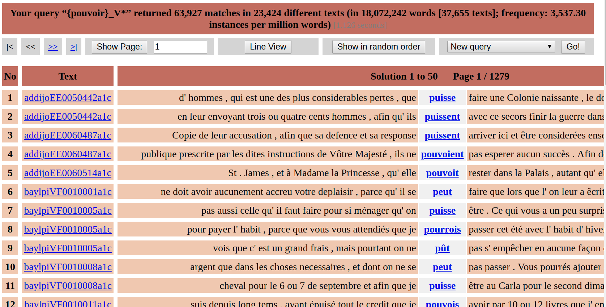
Where we want to get to...for all or most words

Slide 4
tems | temps | NOM | temps
tete | tête | NOM | tête
theatre | théatre | NOM | théatre
tolerable | tolérable | ADJ | tolérable
tolerance | tolérance | NOM | tolérance
tolerans | tolérants | ADJ | tolérant
tolérans | tolérants | ADJ | tolérant
tolerants | tolérants | ADJ | tolérant
tolerant | tolérant | ADJ | tolérant
tolerence | tolérance | NOM | tolérance
tolérerez | tolérez | VER:futu | tolérer
tolerer | tolérer | VER:infi | tolérer
toleré | toléré | VER:pper | tolérer
tolere | tolére | VER:pres | tolérer
toleroit | tolérait | VER:impf | tolérer
tollerançe | tolérance | NOM | tolérance
tollérance | tolérance | NOM | tolérance

Slide 5
Objective – start of the workshop version
<entry>
<form type="historical variant">
<orth>tolérans</orth>
<orth>tolerans</orth>
<orth>tollerans</orth>
</form>
<form type="modern normalized equivalent">
<orth>tolérants</orth>
</form>
<form type="lemma">
<orth>tolérant</orth>
<gramGrp>
<pos>ADJ</pos>
<gen>masc</gen>
<num>plural</num>
</gramGrp>
</form>
</entry>

Slide 6
TEI Dictionary – end of the workshop version
<entry>
<form type="lemma">
<orth>tolérant</orth>
<gramGrp>
<pos>ADJ</pos>
</gramGrp>
</form>
<form type="inflected">
<form type="variant">
<orth norm="tolérants">tolerans</orth>
</form>
</form>
<form type="inflected">
<form type="variant">
<orth norm="tolérants">tolérans</orth>
</form>
</form>

Slide 7
<?xml version="1.0" encoding="UTF-8"?>
<xsl:stylesheet xmlns:xsl="http://www.w3.org/1999/XSL/Transform"
xpath-default-namespace="http://www.tei-c.org/ns/1.0"
version="2.0">
<xsl:output method="xml" indent="yes"/>
<xsl:template name="main" match="/TEI">
<TEI xmlns="http://www.tei-c.org/ns/1.0">
<teiHeader>
<fileDesc>
<titleStmt>
<title>Dictionaire de formes de français du dix-septième siècle</title>
</titleStmt>
<publicationStmt>
<p>Work in progress</p>
</publicationStmt>
<sourceDesc>
<p>Born digital</p>
</sourceDesc>
</fileDesc>
</teiHeader>
<text>
<body>
<xsl:for-each-group select="body/entry" group-by='lemma'>
<entry>
<form type="lemma">
<orth><xsl:value-of select="current-grouping-key()"/></orth>
<gramGrp>
<pos><xsl:value-of select="pos"/></pos>
</gramGrp>
</form>
<xsl:for-each select="current-group()">
<form type="inflected">
<form type="variant">
<orth> <xsl:attribute name="norm"><xsl:value-of select="norm"/></xsl:attribute><xsl:value-of select="orig"/></orth>
</form>
</form>
</xsl:for-each>
</entry>
</xsl:for-each-group>
</body></text></TEI>
</xsl:template>
</xsl:stylesheet>

Slide 8
Thanks to the organizers, I found out about existing work in this area at ATILF in Nancy, and Gilles Souvay has shown me a lemmatizer and sent me the lexicon that it uses.
Discussions with other people in BBAW will lead to new collaborations related to this work!

Slide 9
Next steps
Process the LGeRM dictionary from ATILF to get into the same format, then look for duplicates and how to deal with them.
Offer to share the reformatted and merged data back with ATILF
Retag the corpus, analyse errors, improve lexicon, start again...

